Slide 1

Targeting RNA modifications in cancer
Wednesday 11th of September 2024
Dr Isaia Barbieri
Associate professor
Department of molecular biotechnology and health sciences
Molecular Biotechnology Center
University of Turin
Notes:
Goodafternoon, I’m Prof. Isaia Barbieri from the university of Turin, I teach molecular Biology and lead a research group focused on epitranscriptomics in cancer.

Slide 2
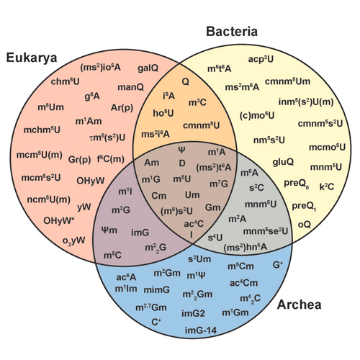
More than 4 bases
INTRO
More than 170 RNA modifications were identified in all kingdom of life, Most of them were firstly identified more than 50 years ago but their characterization was neglected for several decades.
In the last 15 years, the advent of new sequencing technologies allowed for mapping of RNA mods on the transcriptome and open the field to their functional characterization.
(Carell et al.,2012)

Slide 3
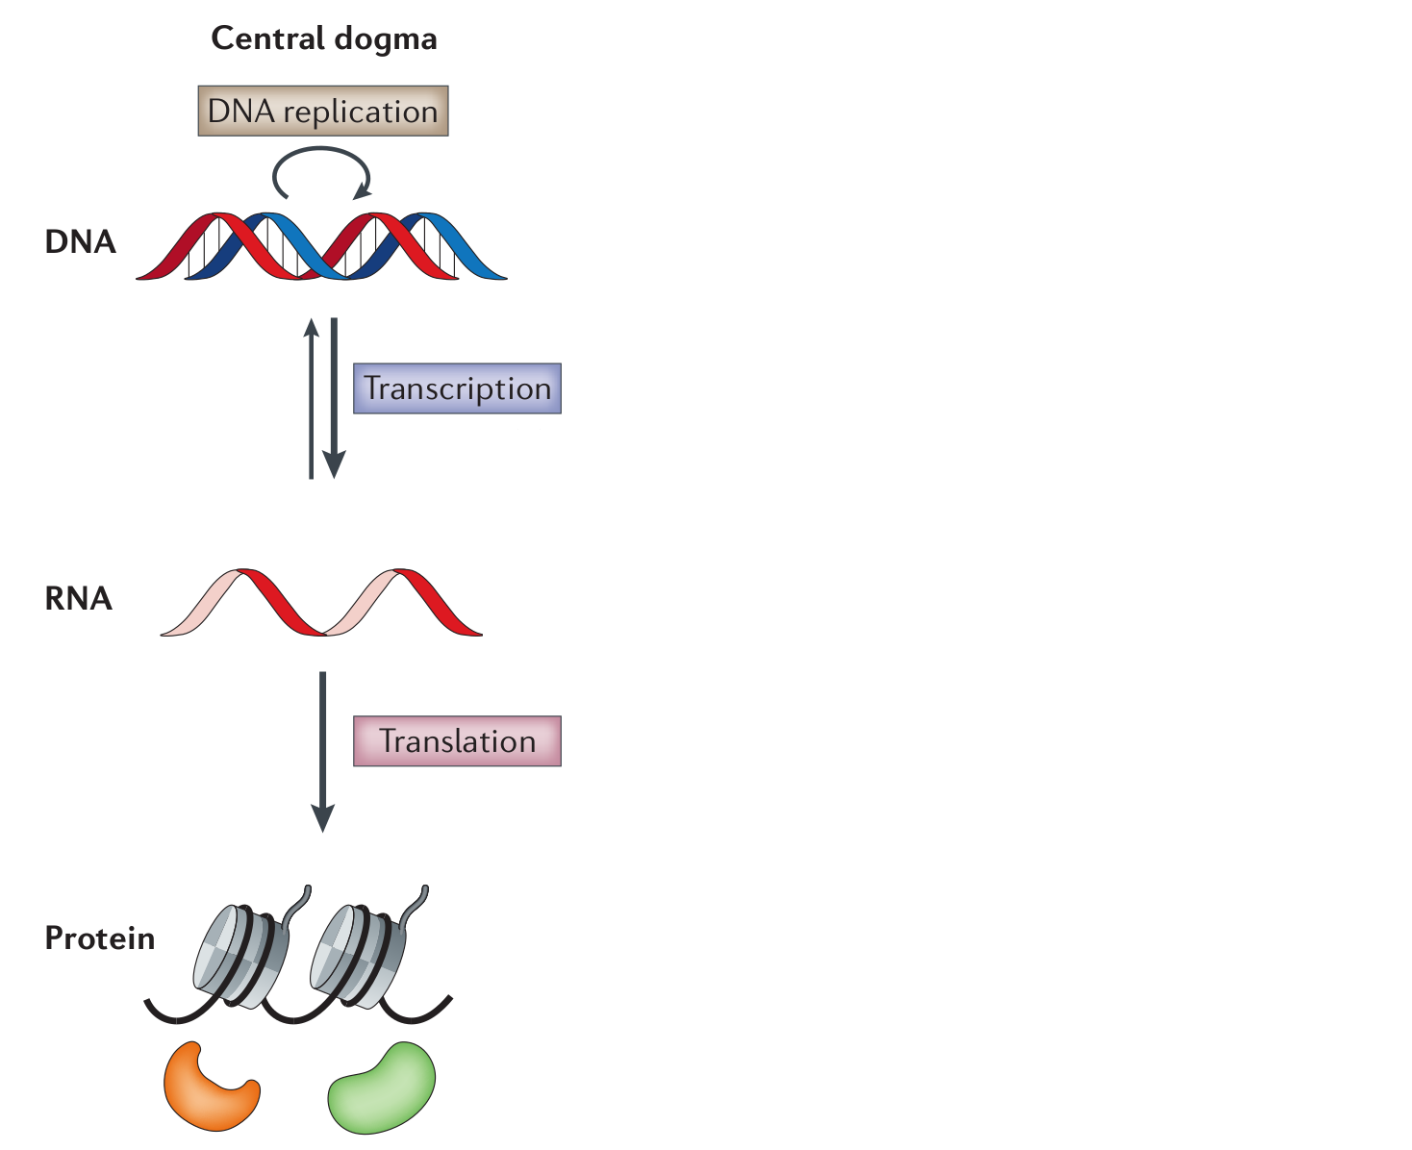
Beyond the dogma, epitranscriptomic regulation of gene expression
INTRO
(Fu et al., 2014)
Notes:
The central dogma of molecular biology...

Slide 4
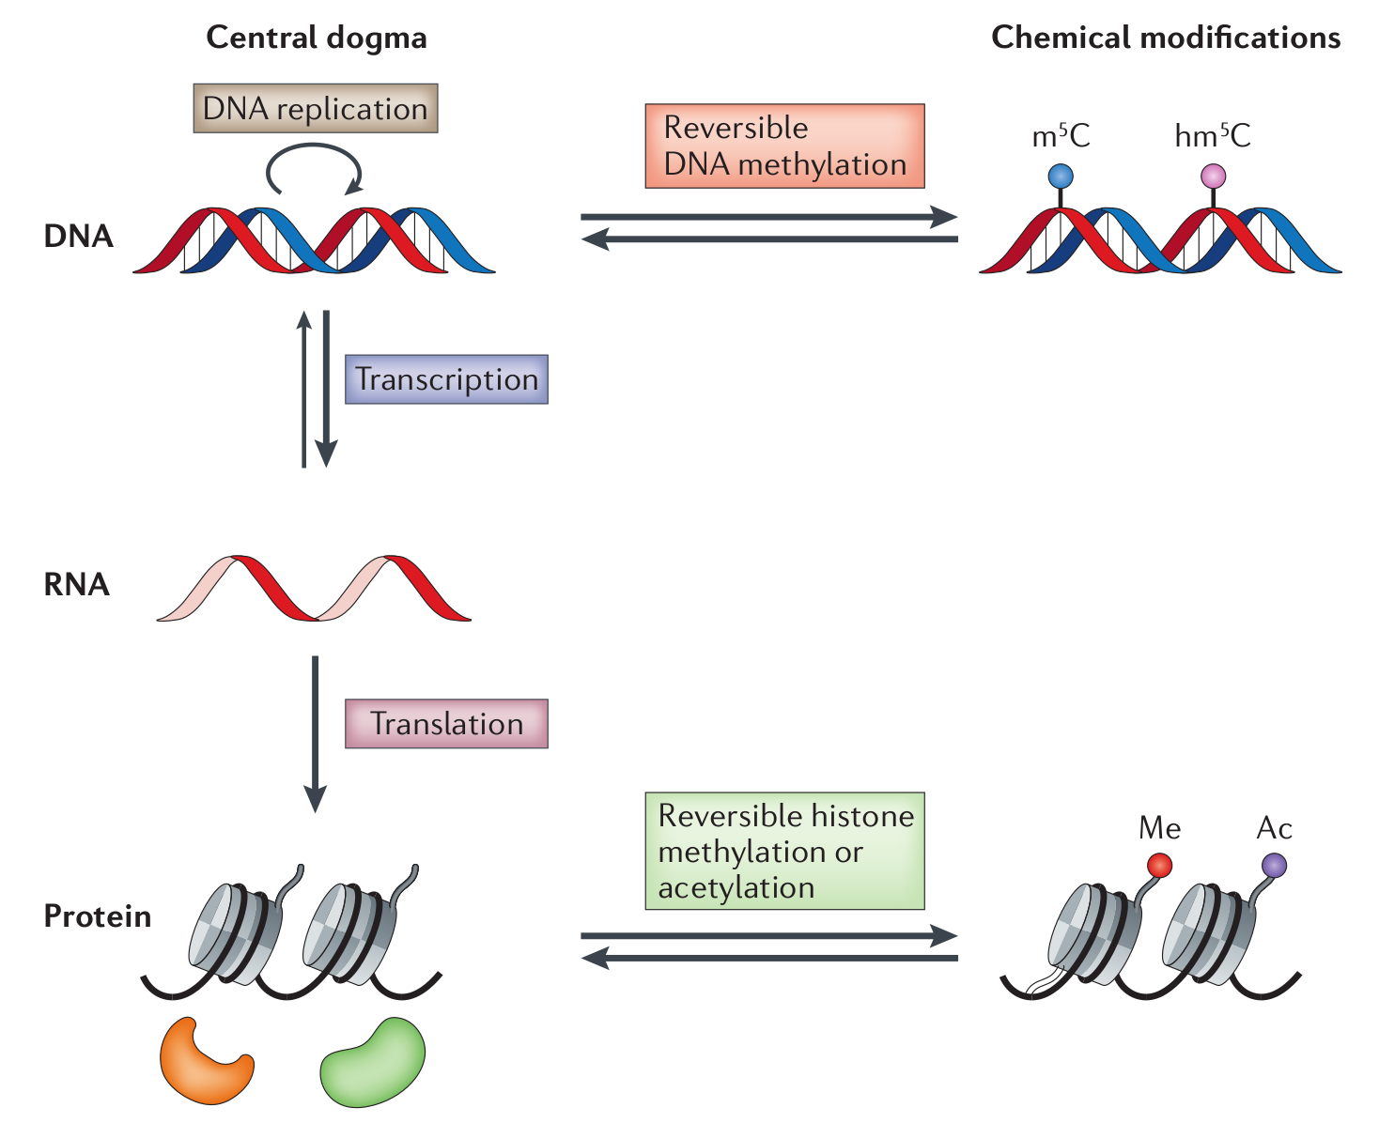
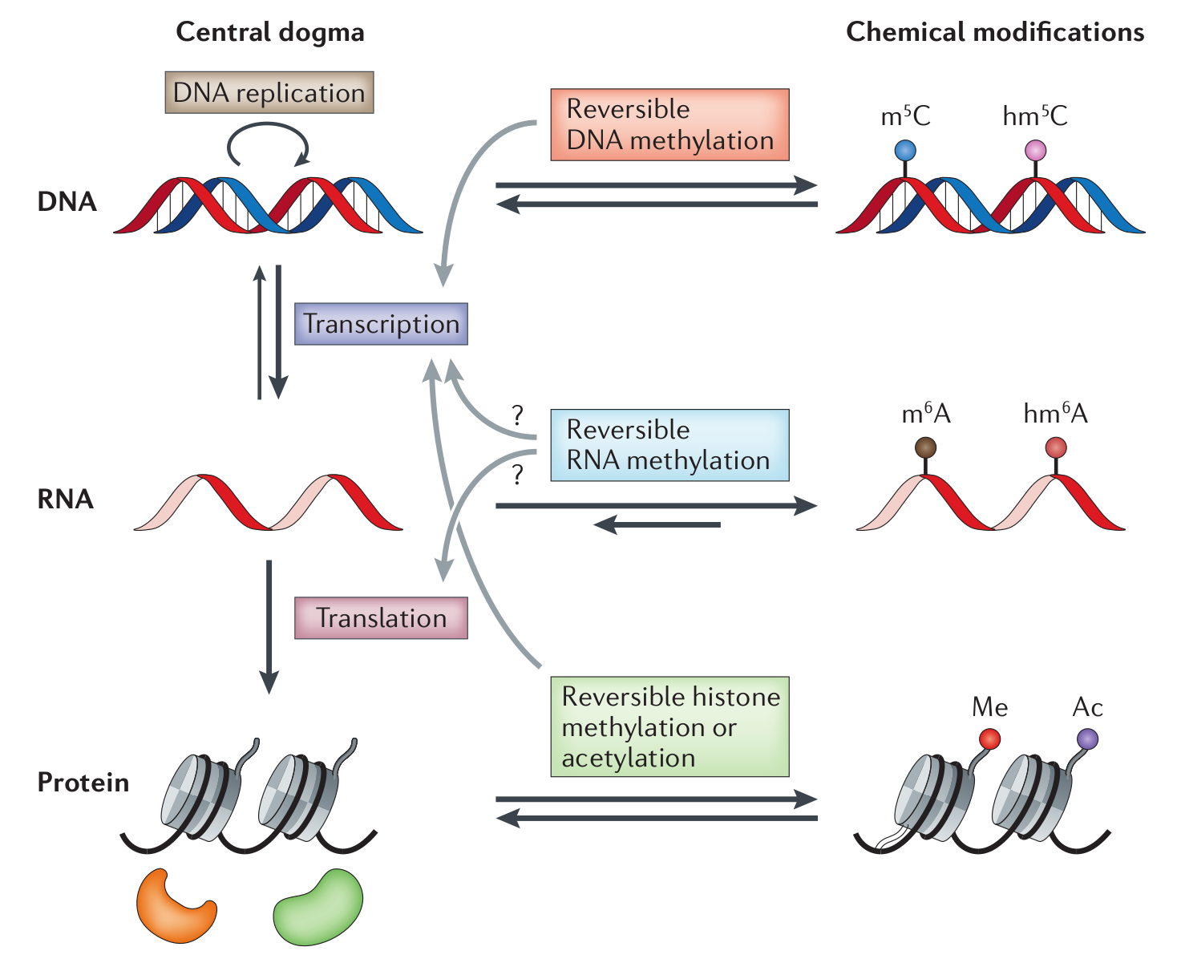
Beyond the dogma, epitranscriptomic regulation of gene expression
INTRO
(Fu et al., 2014)
Notes:
...has been revised and expanded with the addition of reversible DNA and protein covalent modifications, which regulate gene expression and enzymatic activites.

Slide 5
Beyond the dogma, epitranscriptomic regulation of gene expression
INTRO
(Fu et al., 2014)
Notes:
Similarly, it is now well accepted that RNA can also be subject of post-transcriptional modification, regulating its complex life cycle.

Slide 6
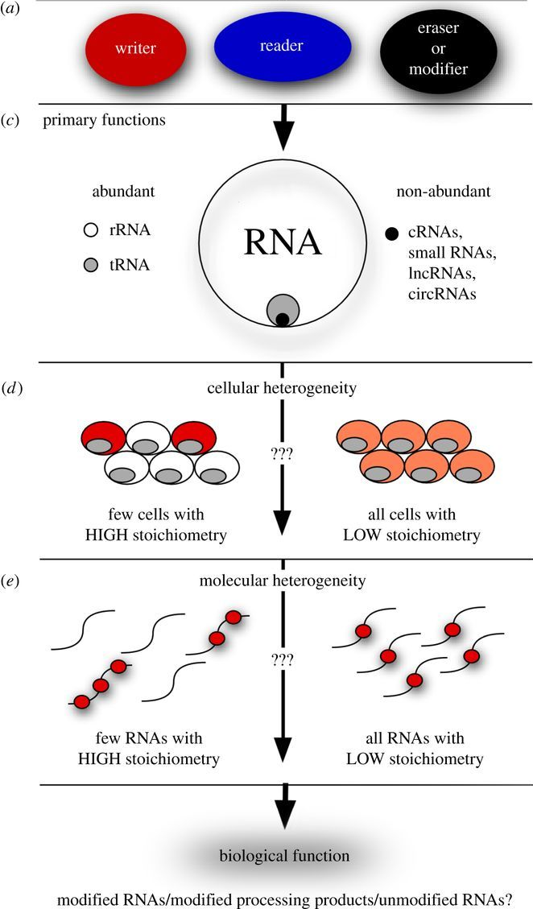
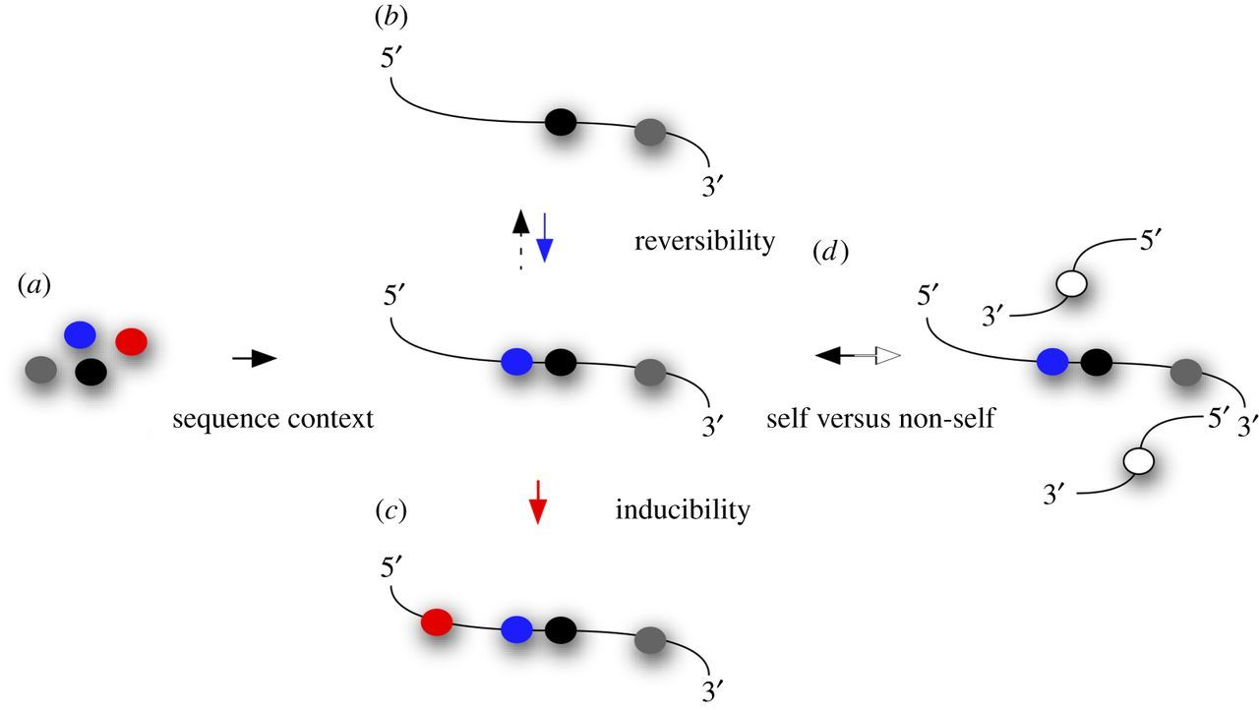
RNA modifications/epitranscriptomics/RNA epigenetics
Key epigenetic questions
Schaefer et al. Open Biology, 2017
Notes:
Epitranscriptomics, as you probably already discussed during this course, is the field of research that studies post-transcriptional modifications of RNA. Epitrasncriptomics mark may or may not constitute truly epigenetic marks depending on how strict of a definition of epigenetics we use. There are still many open questions about RNA modifications, for example how they can affect primary RNA functions, their cellular heterogeneity and molecular heterogeneity. We know that specific RNA modifications are dynamic, specific and reversible.

Slide 7
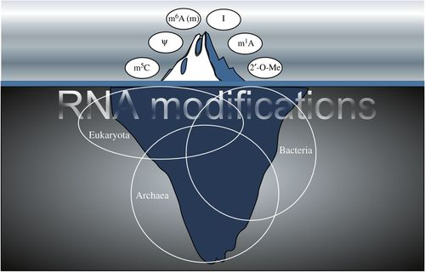
RNA modifications
Notes:
Our current knowledge of RNA mods is still relatively limited and there is probably many specific epitranscriptomic molecular mechansims and biological functions.

Slide 8
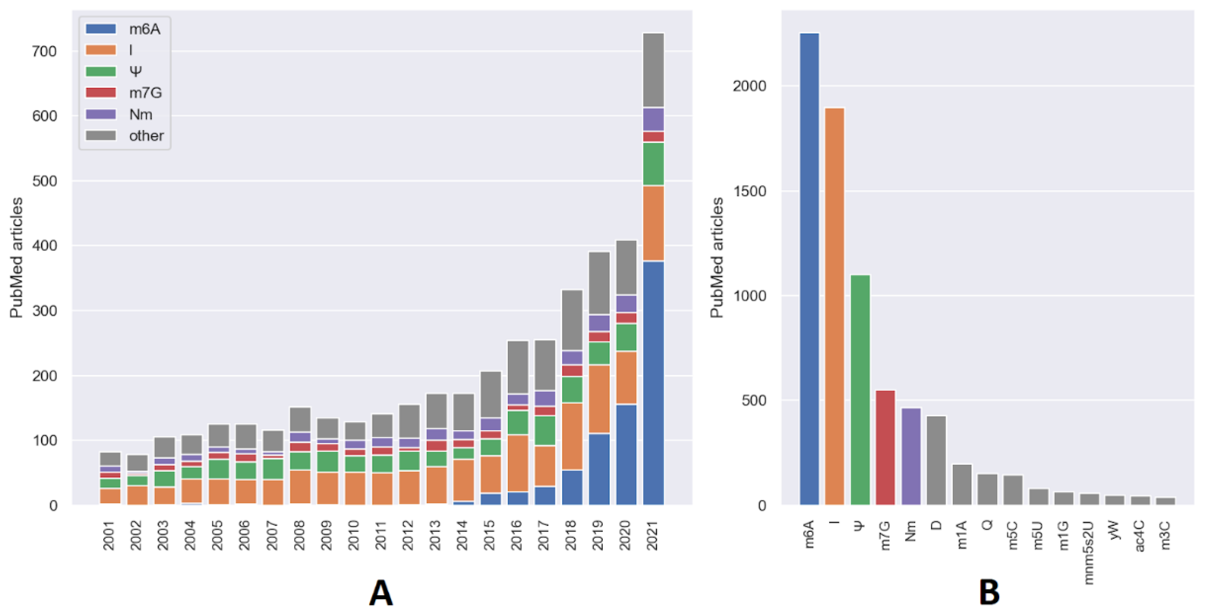
Epitranscriptomic studies
Notes:
As you can se from the slide in the last decade there hs been a significant grow in the number of RNA modifications studies, although focusing on very few modifications.

Slide 9
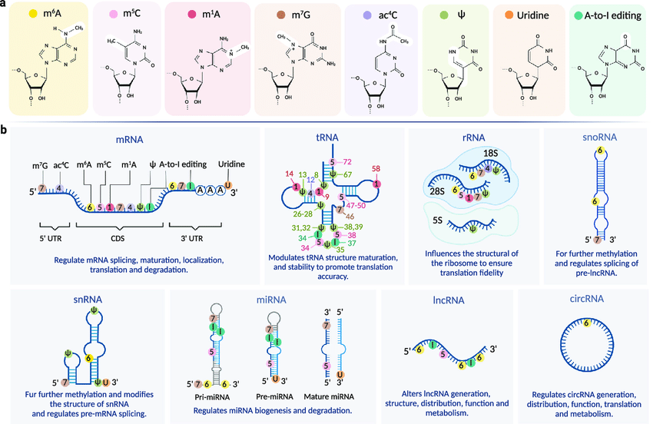
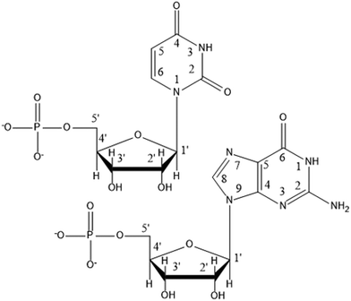
RNA modifications
Uracil
Guanosine
Zhang et al. Trends in molecular medicine, 2016
Notes:
RNA modifications can occur on any part of all four nitrogenous bases and ribose sugar, are found in all RNA subtypes and can include adding chemical groups, such as methylations or removal of chemical group such as deamination in Adenine to inosine conversion.

Slide 10
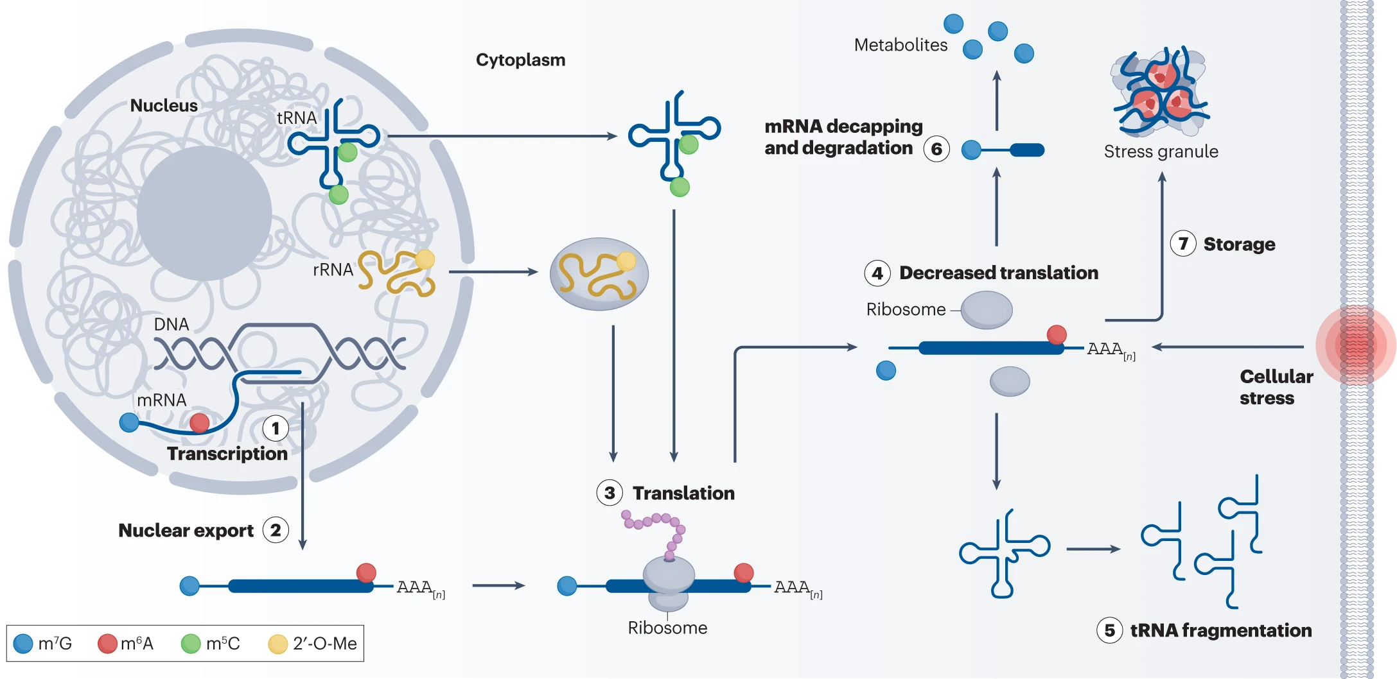
Functions of RNA modifications

Slide 11
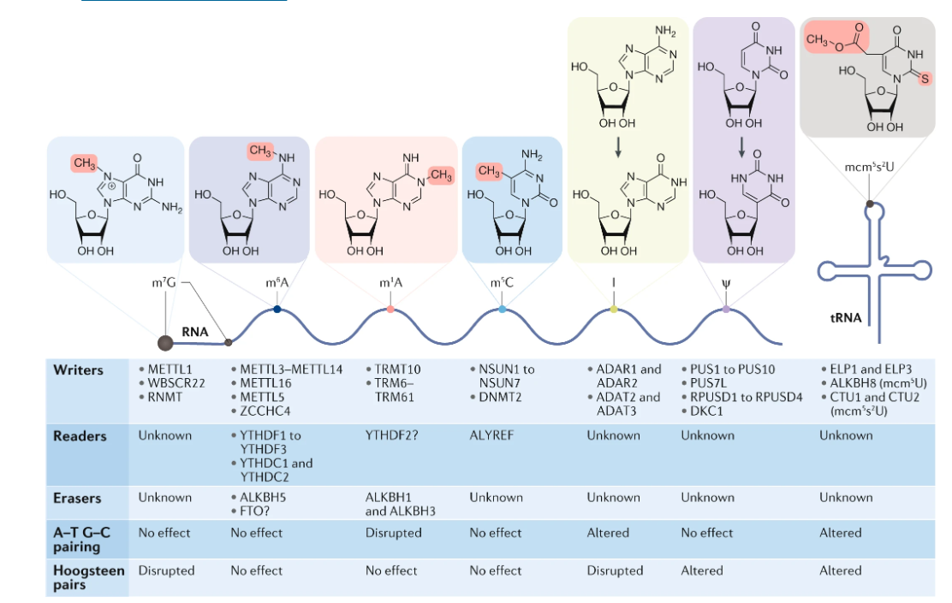
RNA modifications
Barbieri and Kouzarides, Nature reviews cancer, 2020
Notes:
Here are RNA modification with known roles in cancer and the main we identified writers for all of them while our understanding of both readers and erasers is still somewhat limited. Amongst them we have four primary methylation a deamination an isomerization and a complex

Slide 12
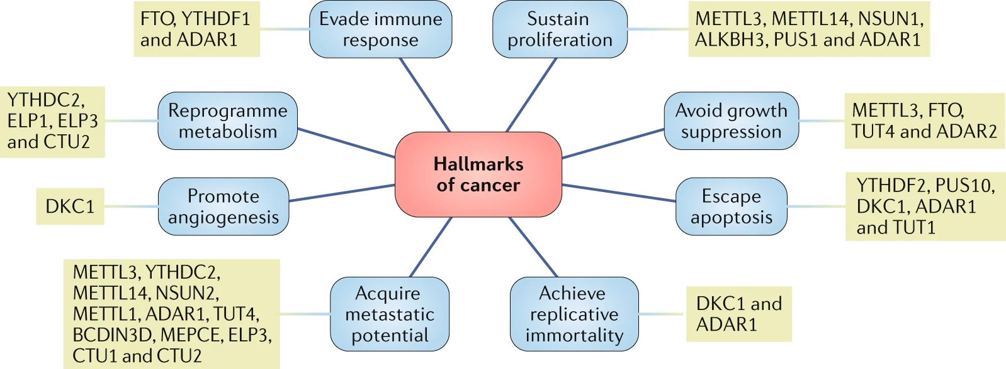
RNA modifications and the hallmarks of cancer

Slide 13
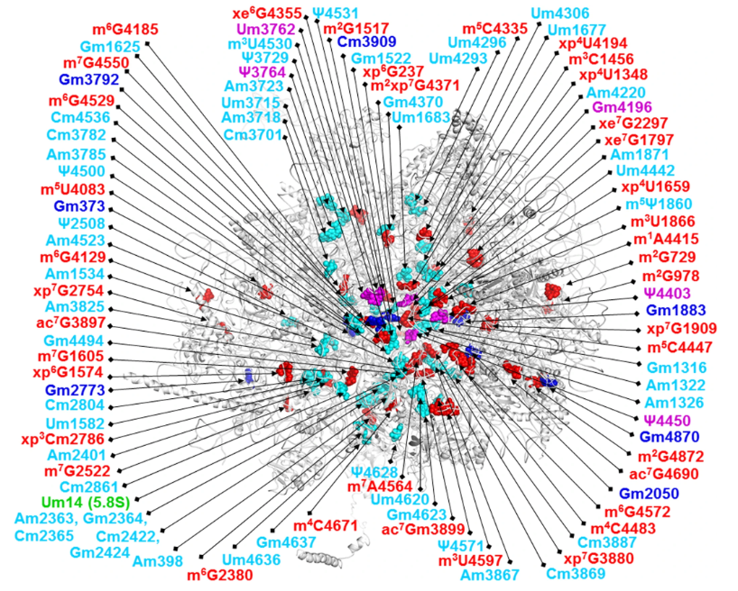
rRNA modifications
Highly heterogeneous
Highly redundant
Direct modification
RNA-guided modification
Involved in ribosomal RNA maturation
Collectively affecting translation efficiency and accuracy.
Open questions:
Stoichiometry
Regulation
Ribosomal heterogeneity
Nicholson et al. Nature Communications volume 13, Article number: 591 (2022)

Slide 14
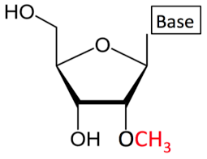
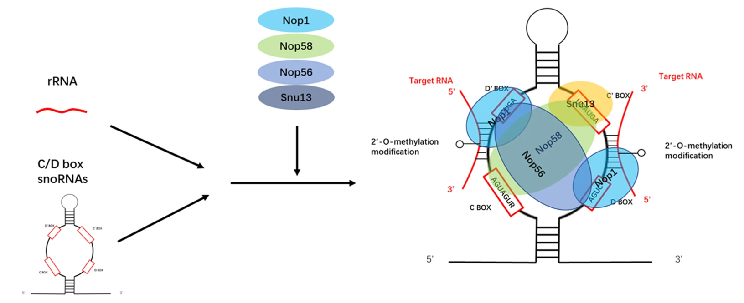
rRNA snoRNA-guided 2'O-methylation

Slide 15
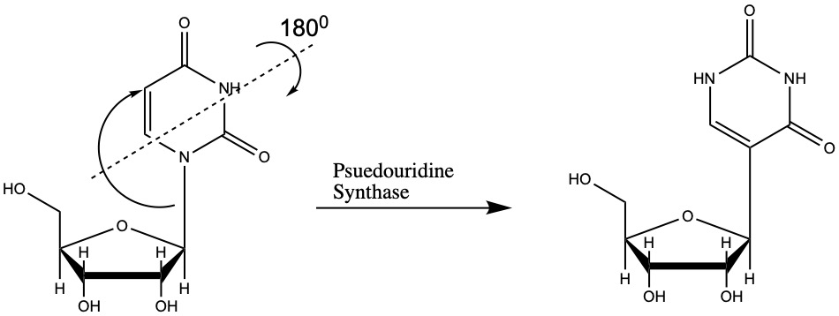
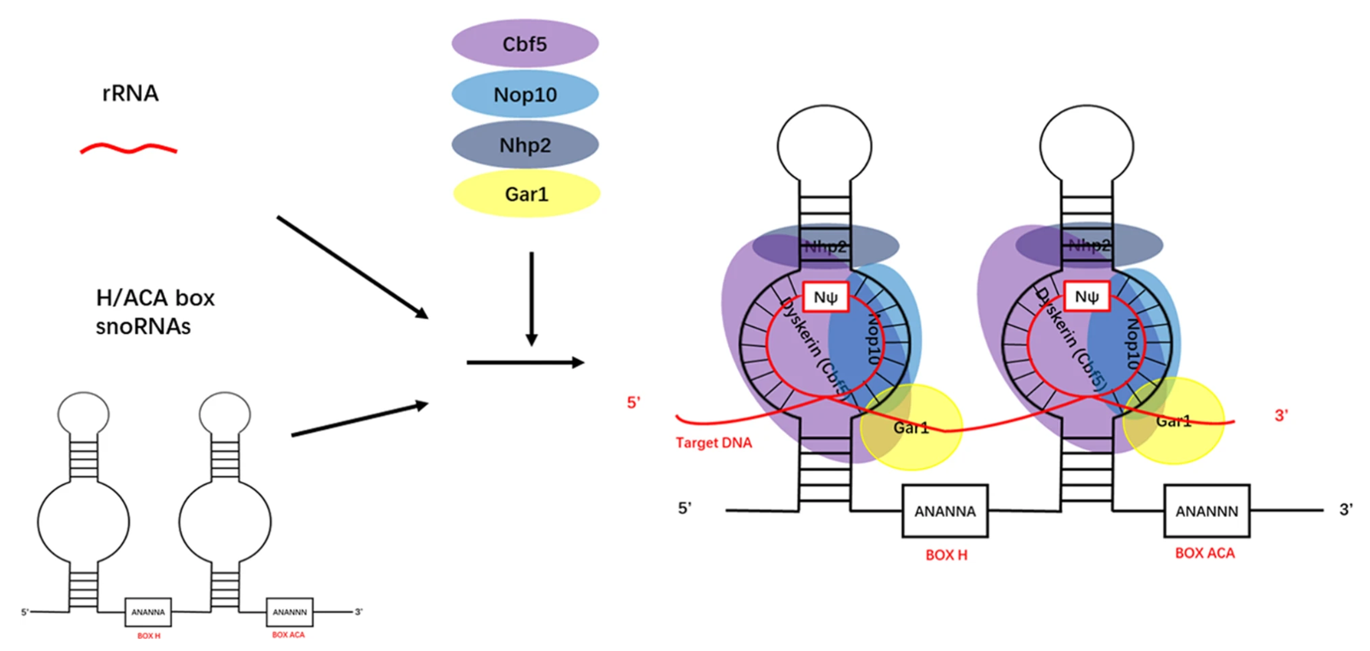
rRNA snoRNA-guided Pseudourydilation (Ψ)

Slide 16
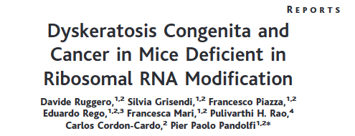
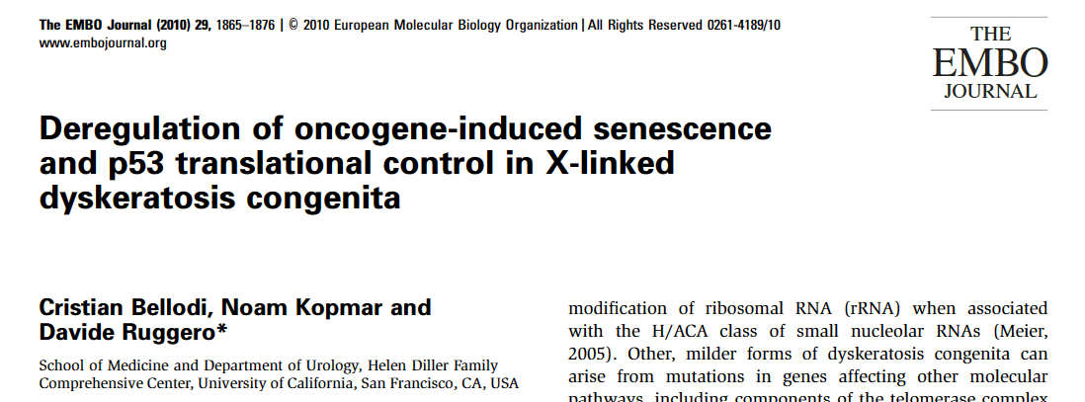

Slide 17
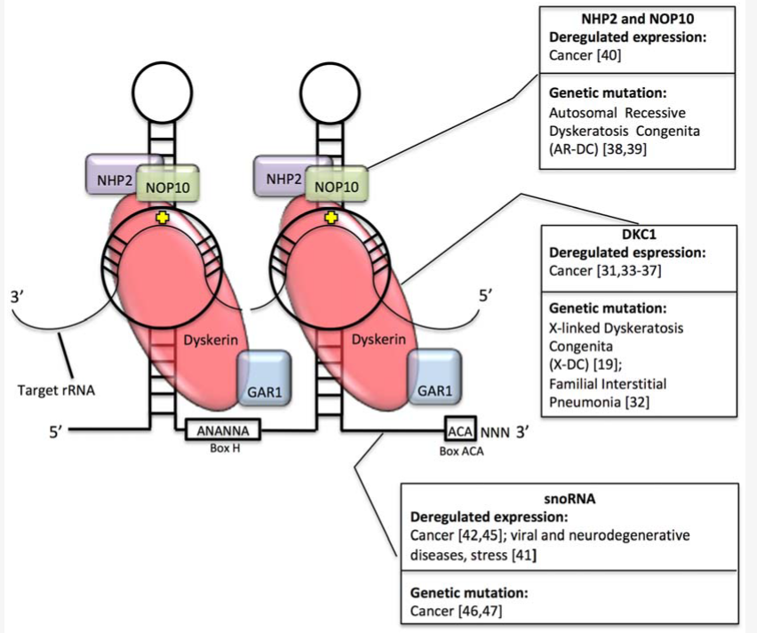
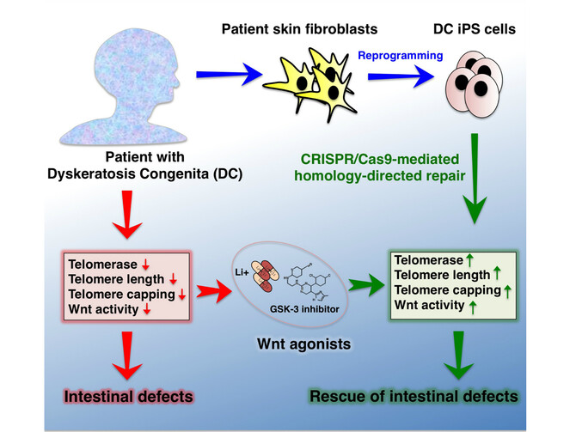
rRNA snoRNA-guided Pseudourydilation (Ψ)
Mutations within the rRNA pseudourydylation cause dyskereatosis congenita caused by deficient telomer maintenance. At the same the enzymes and snoRNAs are upregulated in cancer.
Penzo M and Montanaro L Biomolecules 2018

Slide 18
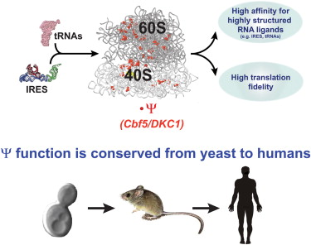
rRNA snoRNA-guided Pseudourydilation (Ψ)
Decreased P53 translation
Increased IRES-dependent VEGF translation
Penzo M and Montanaro L, Biomolecules 2018
Jack K et al. Mol Cell 2011

Slide 19
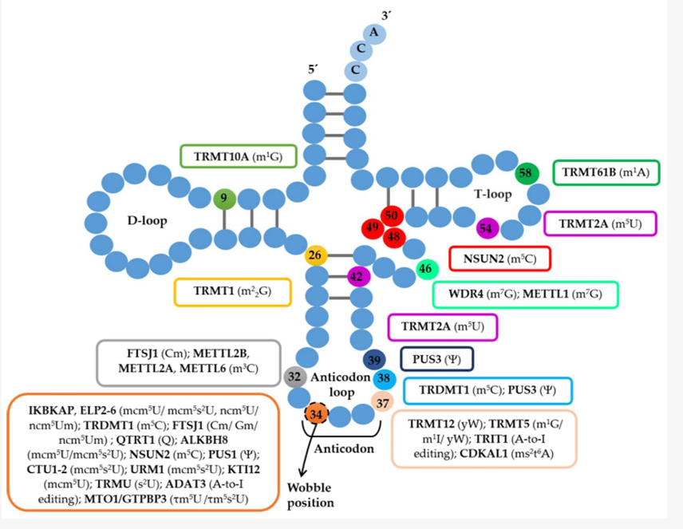
tRNA modifications
Non-wobble position mods:
Mainly primary methylations
Affecting stability and secondary conformation.
Wobble position mods:
Highly heterogeneous and complex
Required for proper decoding
Open questions:​
Stoichiometry​
Regulation ​
tRNA heterogeneity​

Slide 20
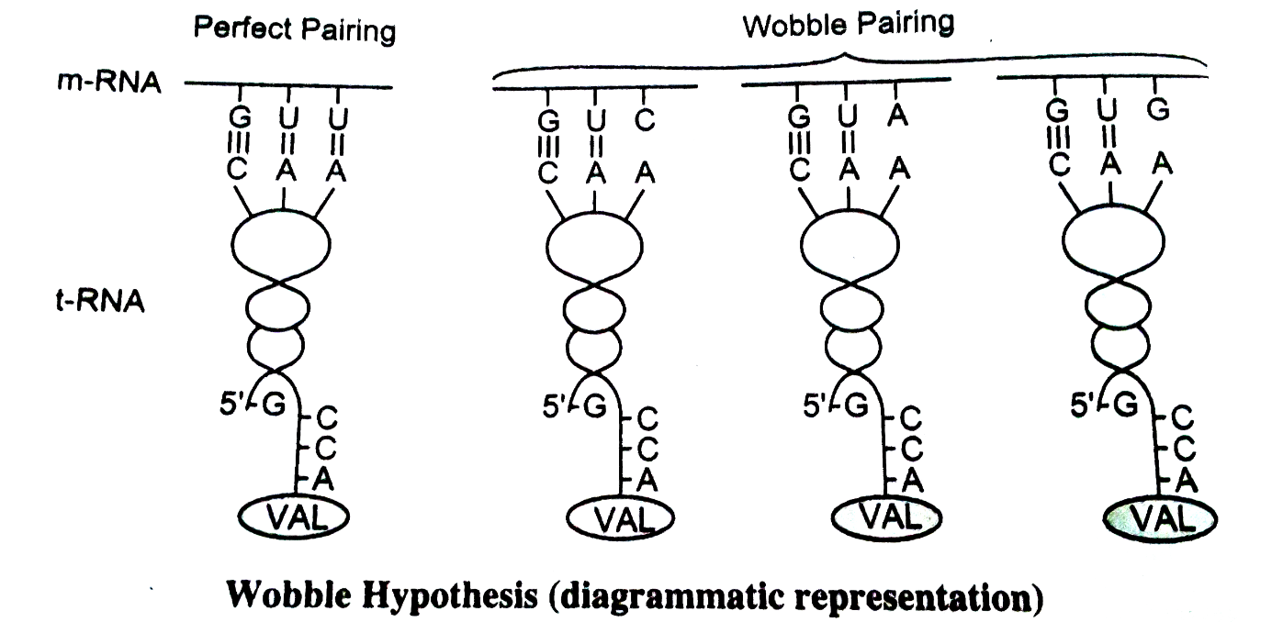
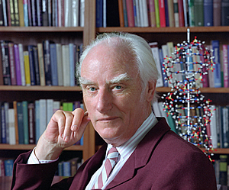
tRNA modifications wobble hypothesis
The wobble hypothesis was firstly suggested by Francis Crick. Imperfect codon-anticodon pairing would allow for multiple codons to encode for the same amino acid.

Slide 21
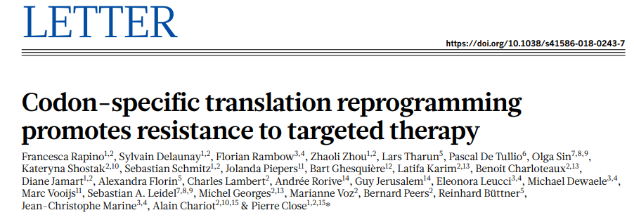

Slide 22
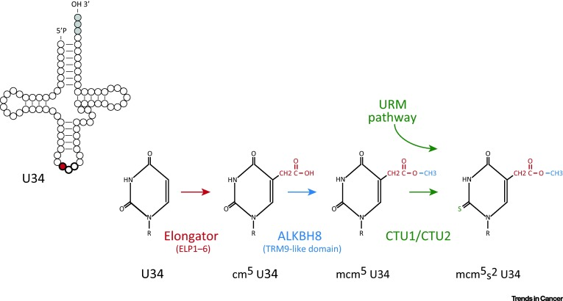
tRNA modifications wobble hypothesis: U34 modification
The U34 wobble nucleotide withing a subgroup of tRNAs is highly modified to allow for promiscuous pairing.
tRNALysUUU,
tRNAGluUUC,
tRNAGlnUUG

Slide 23
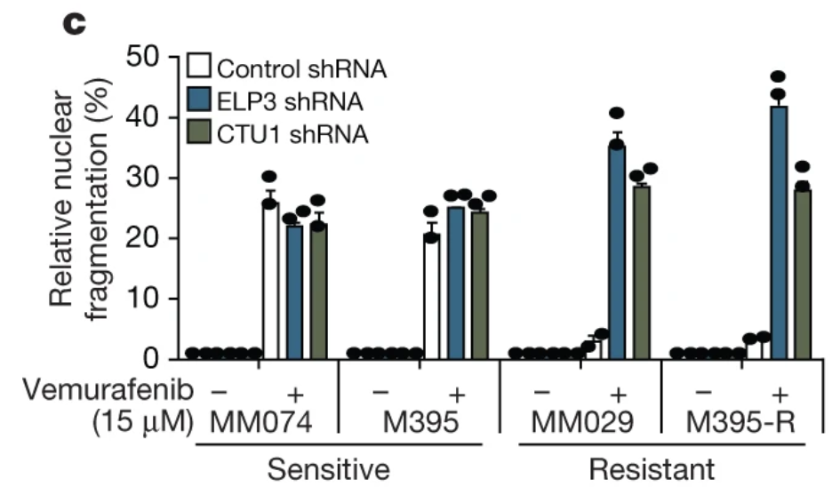
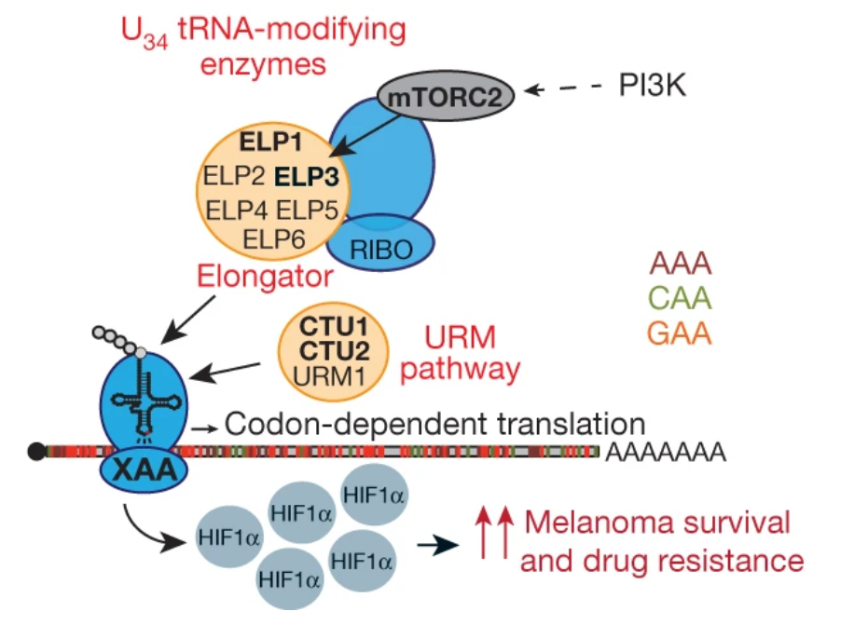
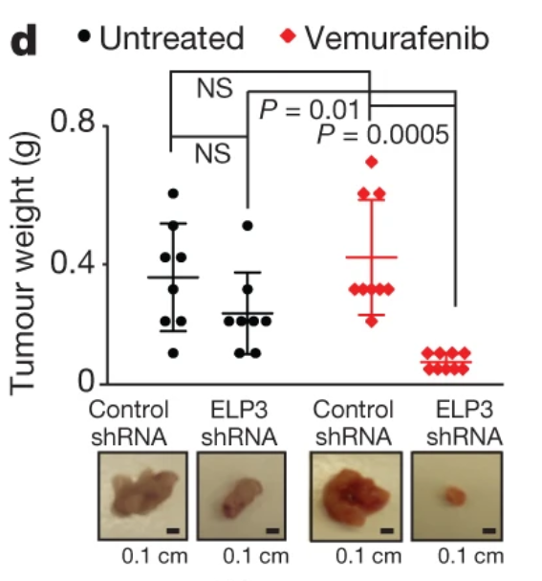
tRNA modifications wobble hypothesis and cancer
U34-modifying enzymes are upregulated in Vemurafenib-resistant melanoma cells to enhance HIF1a translation.

Slide 24
mRNA modifications
Small number of primary modifications
Low, variable Stoichiometry
Specific topology
Sun H et al. Nature reviews molecular biology, 2023

Slide 25
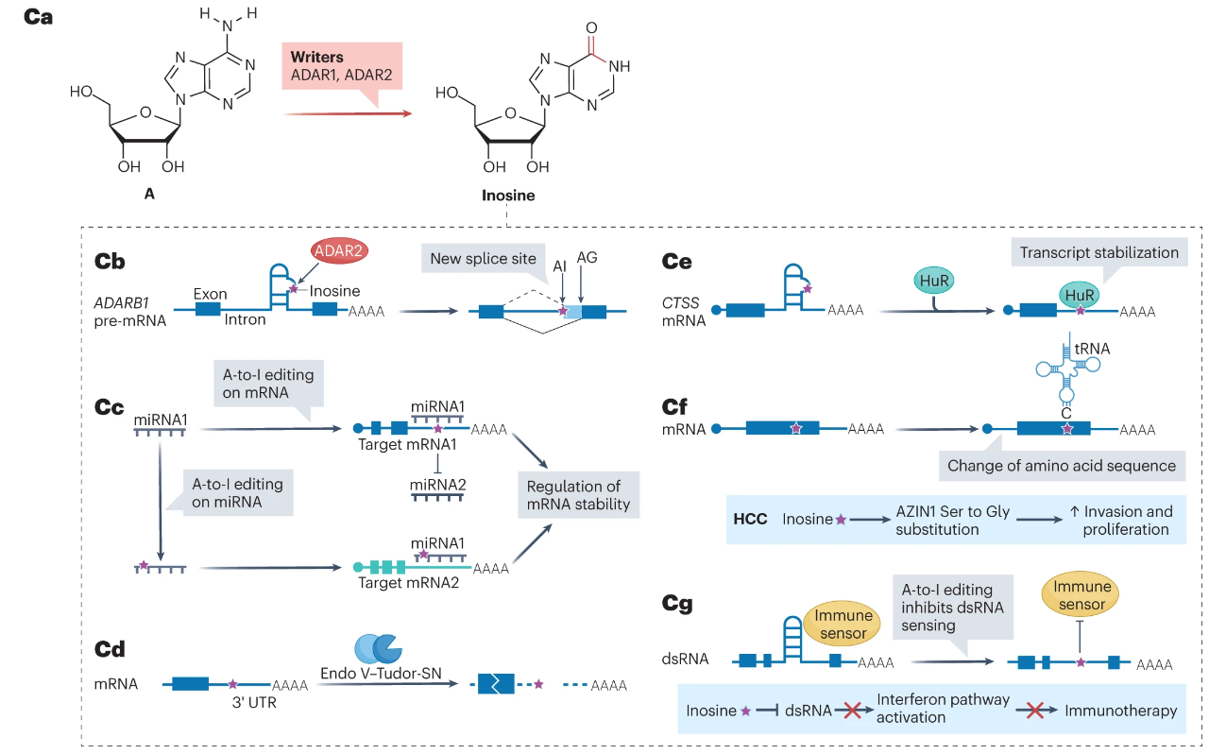
mRNA modifications: Inosine
Sun H et al. Nature reviews molecular biology, 2023

Slide 26
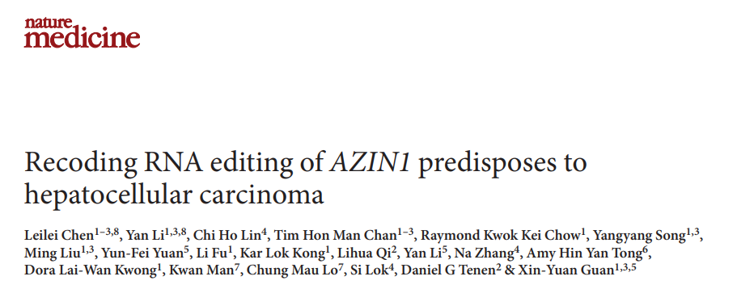

Slide 27
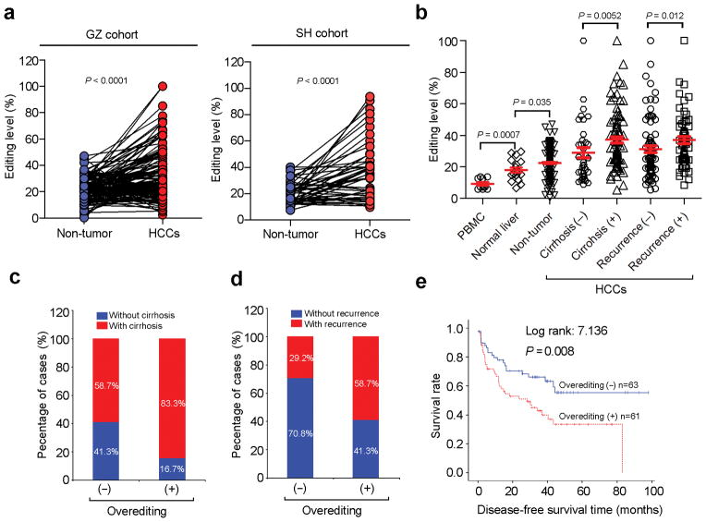
mRNA modifications: RNA editing in cancer
AZIN1 A-I editing correlates with tumor progression and poor prognosis in HCC.
AZIN1= Antizime inhibitor1
Chen L et al Nat Med. 2013

Slide 28
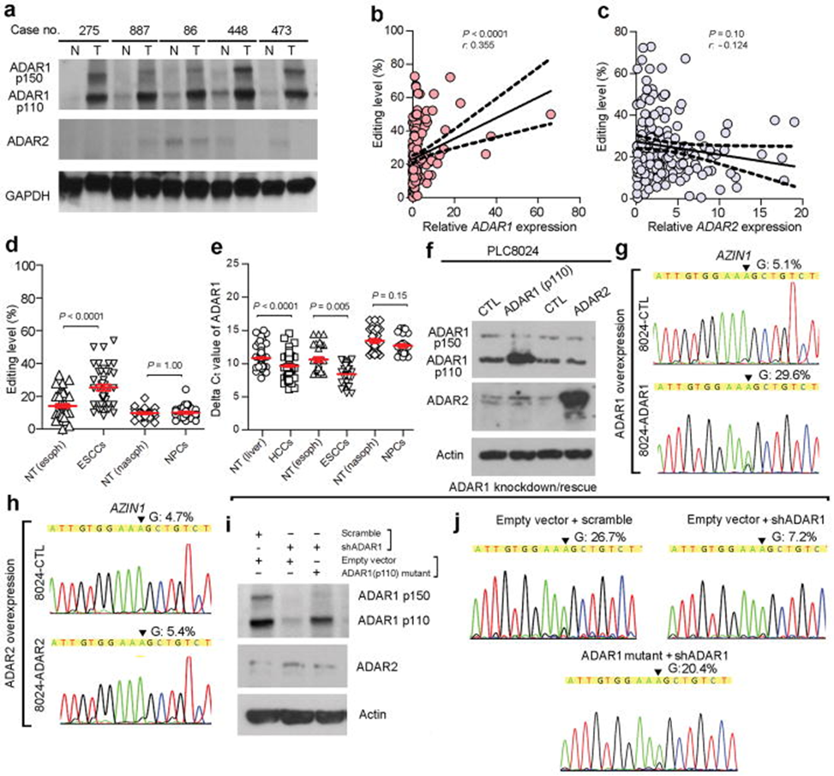
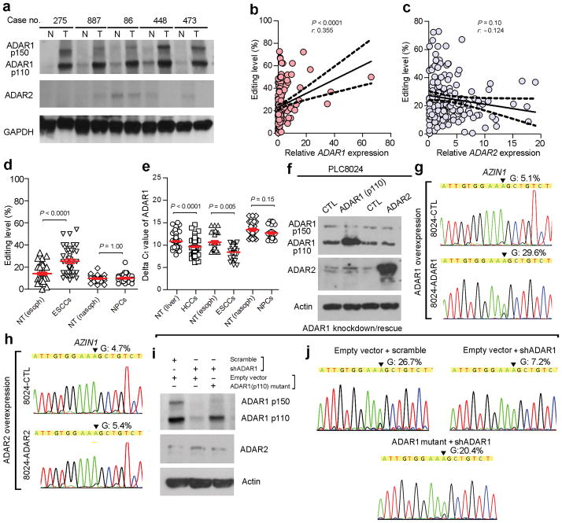
mRNA modifications: RNA editing in cancer
AZIN1 A-I editing is dependent on ADAR1 activity.
Chen L et al Nat Med. 2013

Slide 29
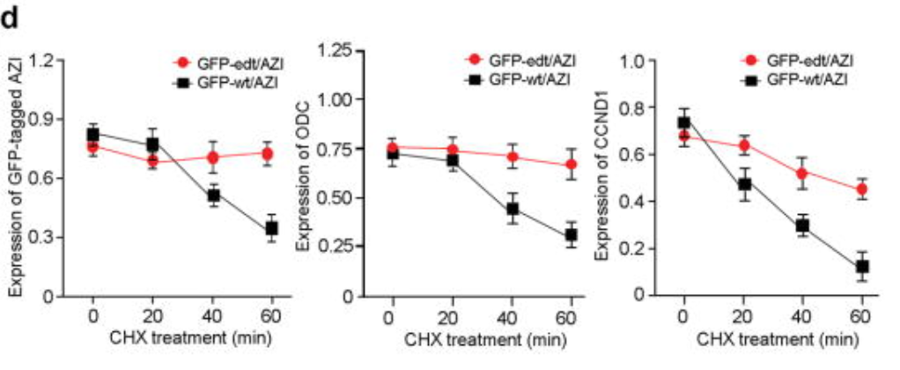
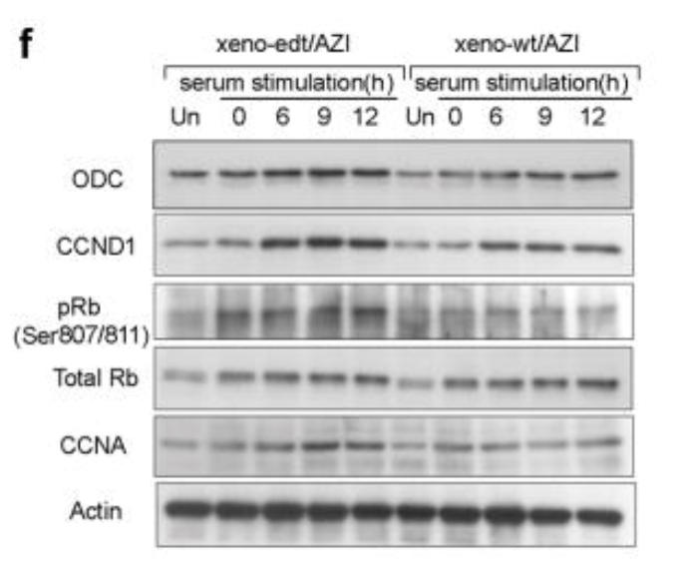
mRNA modifications: RNA editing in cancer
Edited-AZIN1 protects oncoproteins from Antizyme-dependent degradation in esophageal cancer cells.
Chen L et al Nat Med. 2013

Slide 30
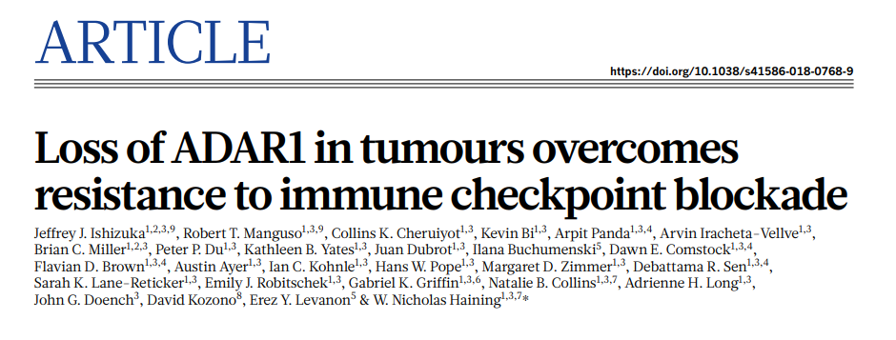

Slide 31
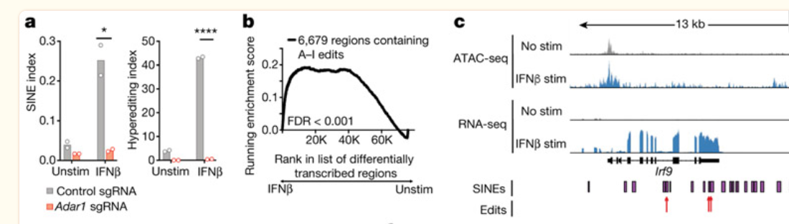
mRNA modifications: RNA editing in cancer
ADAR1 edits SINE (Short Interspersed Nuclear Element) induced by IFNβ

Slide 32
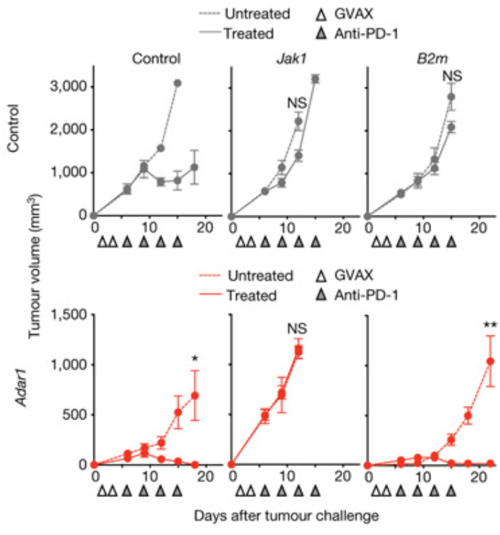
mRNA modifications: RNA editing in cancer
ADAR1 targeting restores immunotherapy sensitivity in b2m KO melanoma cells (IFN sensitive) but not in JAK1 KO cells (IFN insenstive).

Slide 33
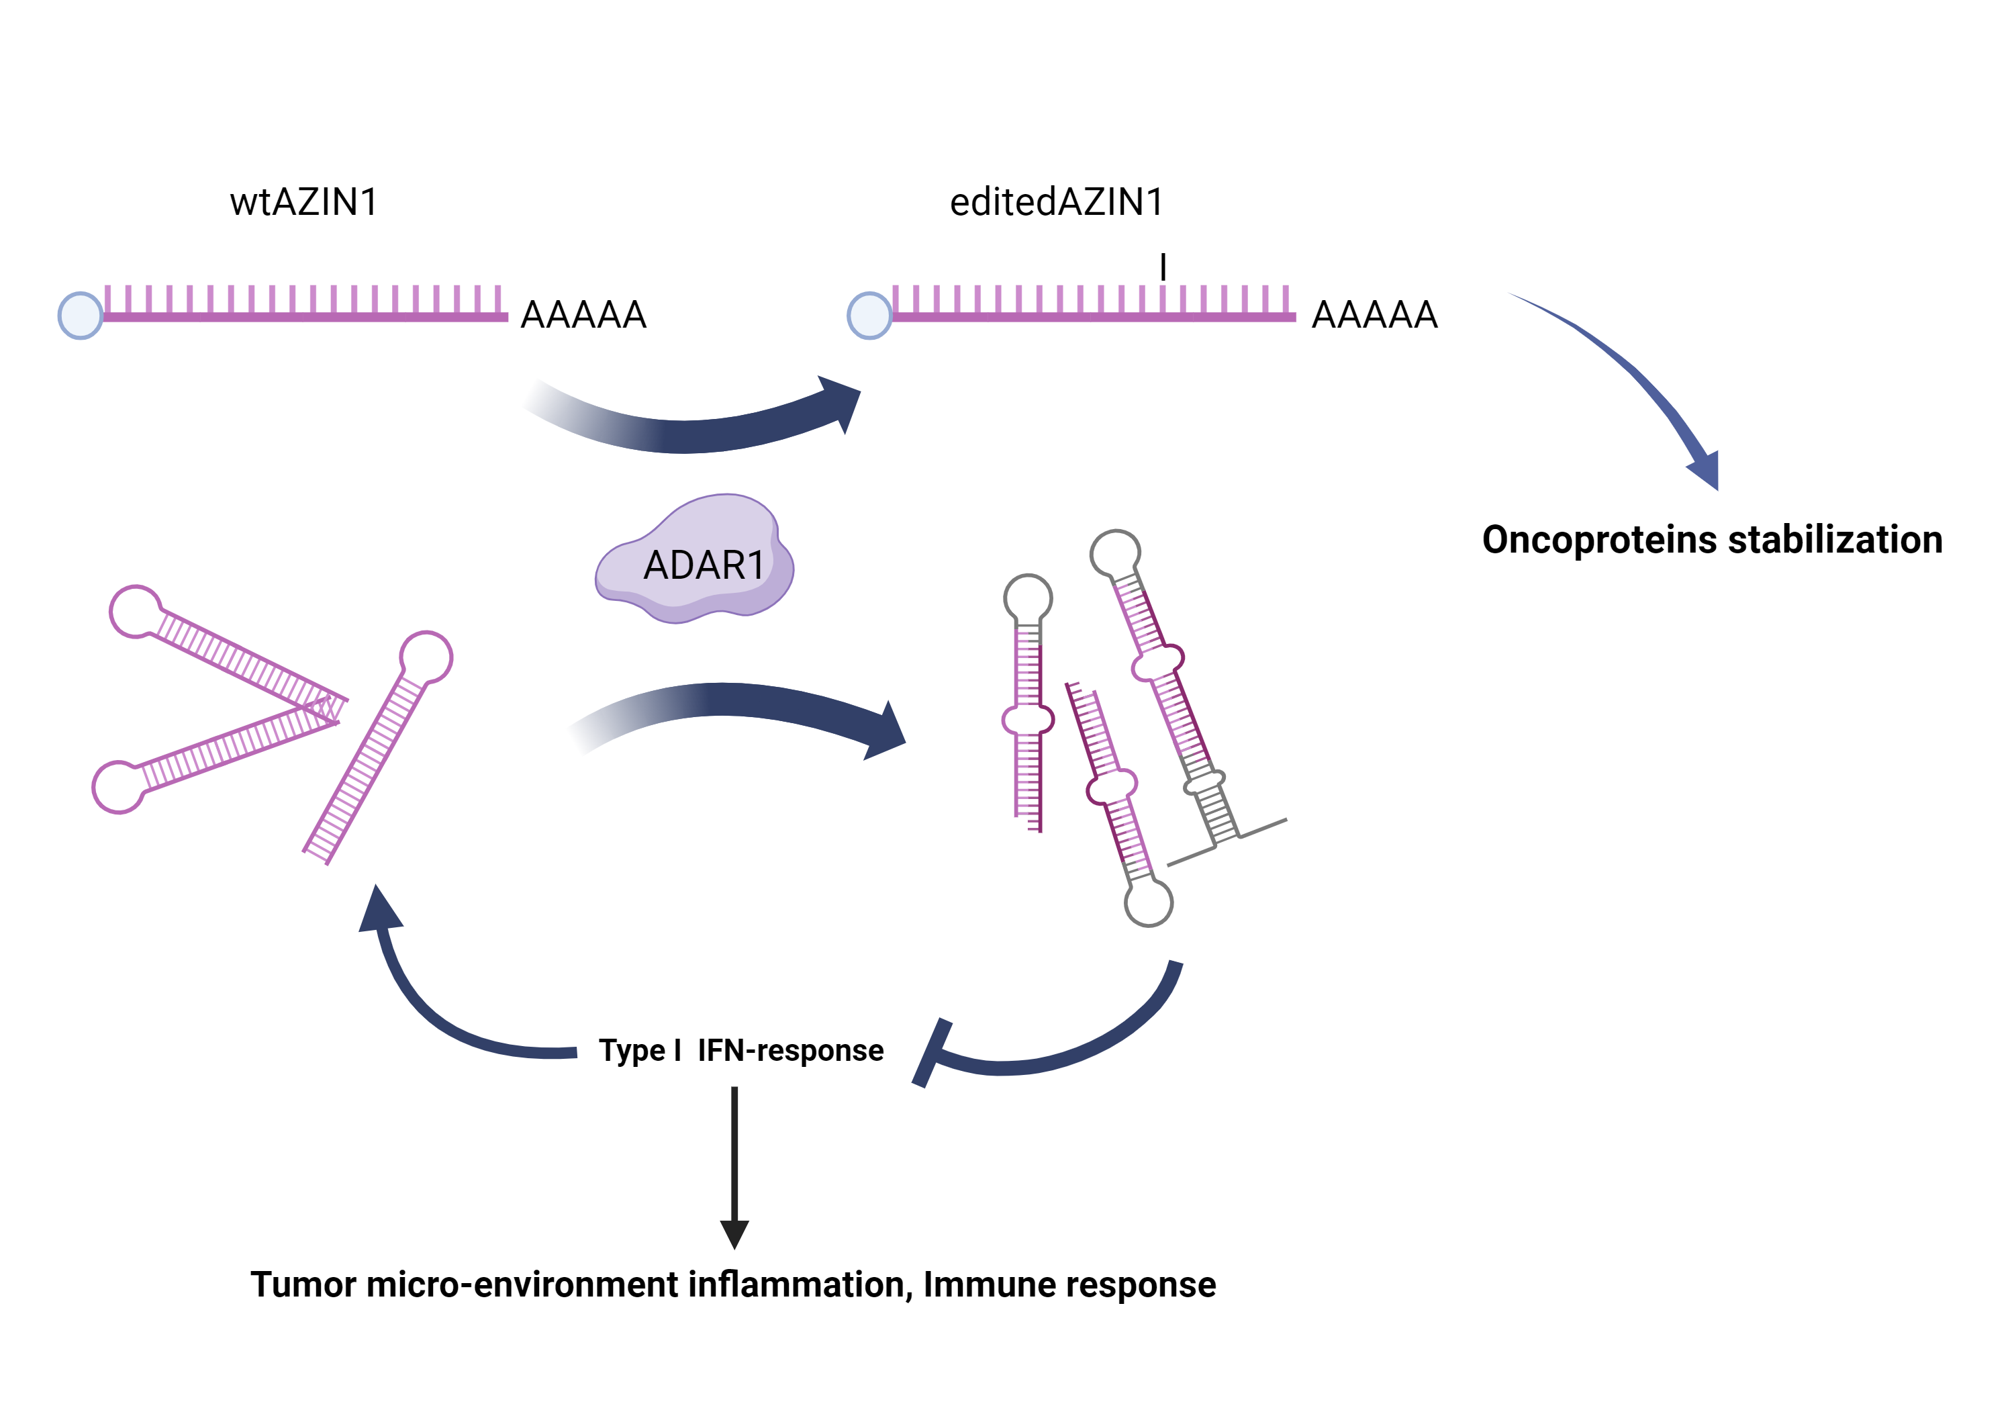
mRNA modifications: RNA editing in cancer

Slide 34
mRNA modifications: m6A
Hong J et al. Experimental & Molecular Medicine volume 54, pages1822–1832 (2022)

Slide 35
mRNA modifications: m6A readers
Deng X et al. Nature reviews clinical oncology 2023

Slide 36
mRNA modifications: m6A in cancer
Barbieri and Kouzarides, Nature Reviews Cancer, 2020

Slide 37
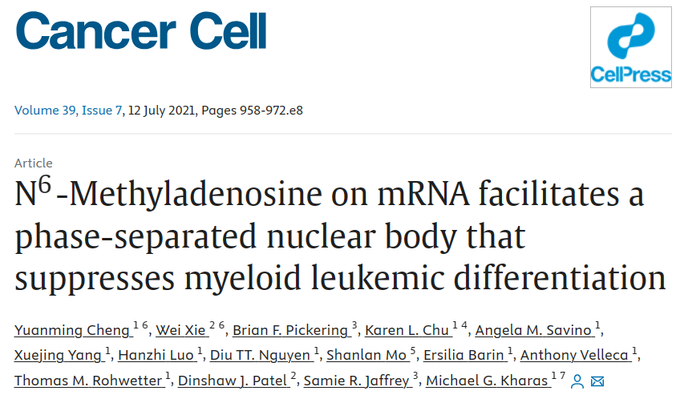

Slide 38
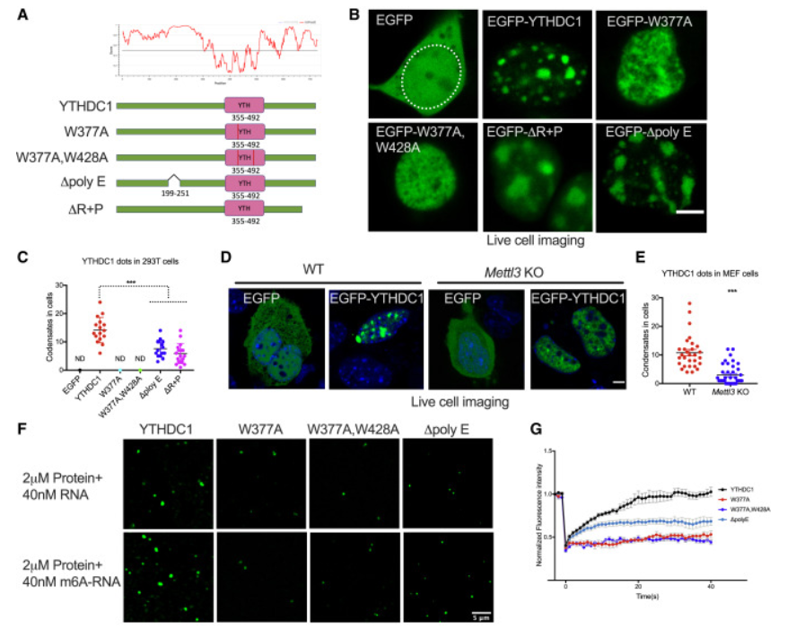
mRNA modifications: m6A in cancer
YTHDC1 LLPS is dependent on m6A-RNA binding.

Slide 39
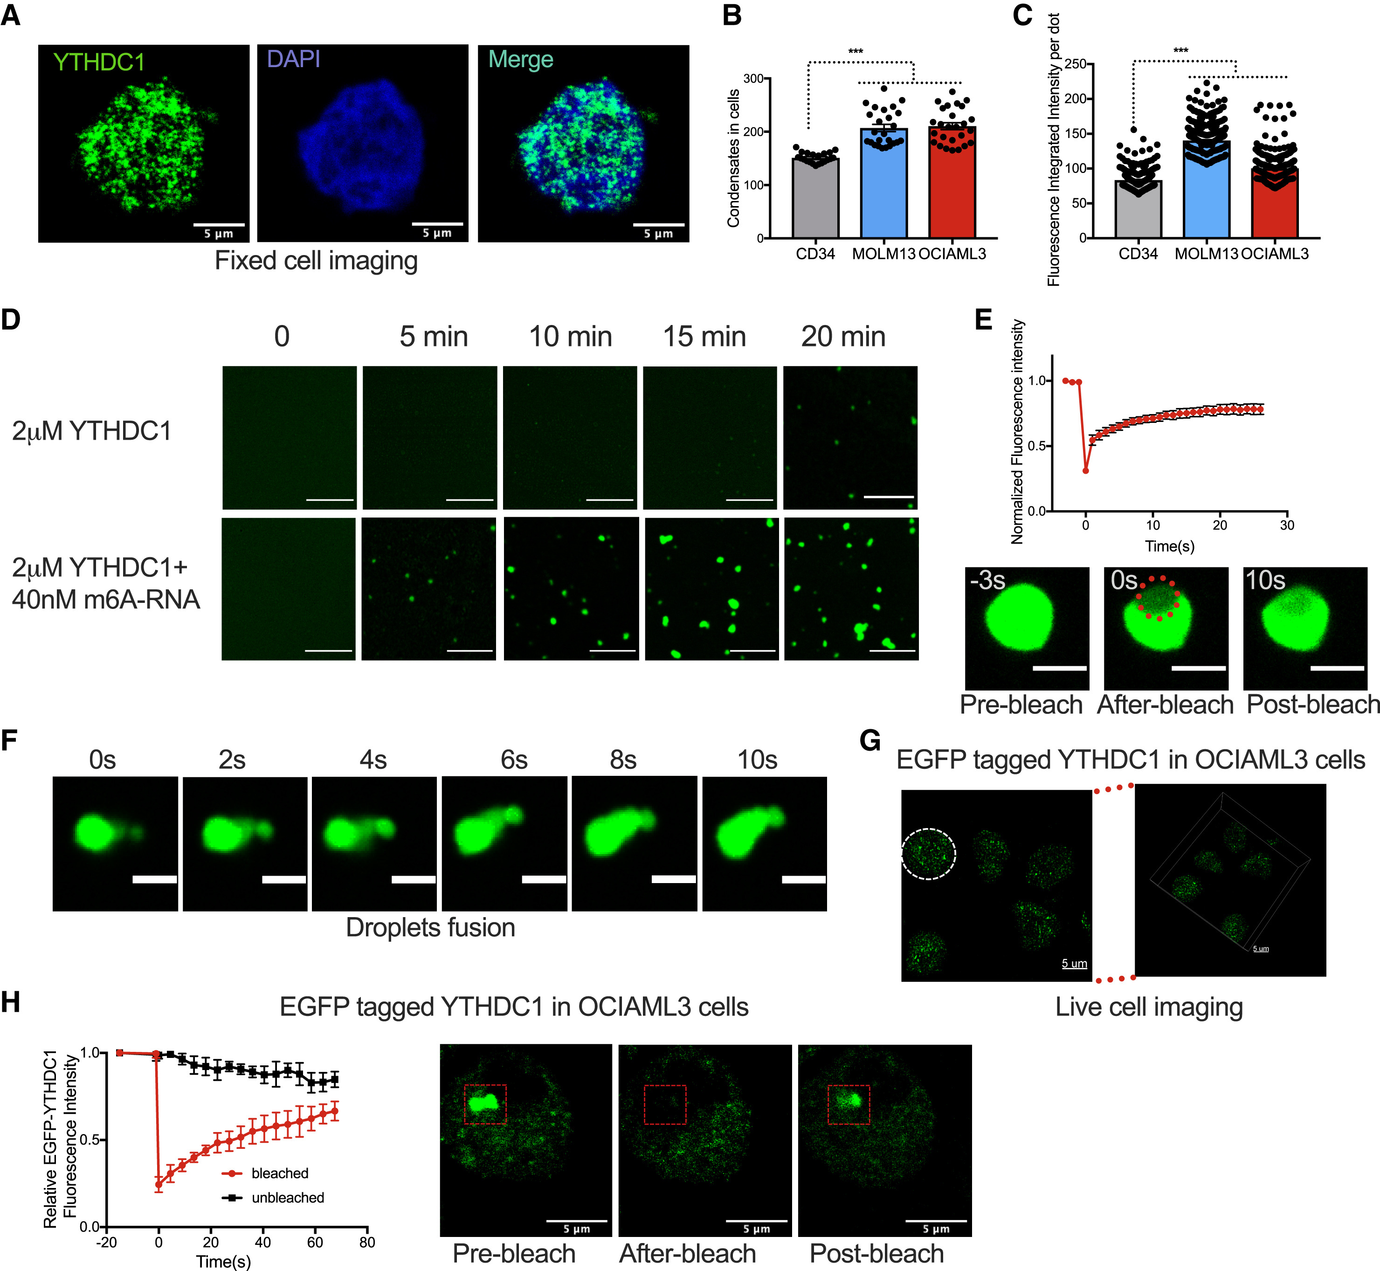

mRNA modifications: m6A in cancer
YTHDC1 undergoes LLPS condensates in leukaemia cells.

Slide 40
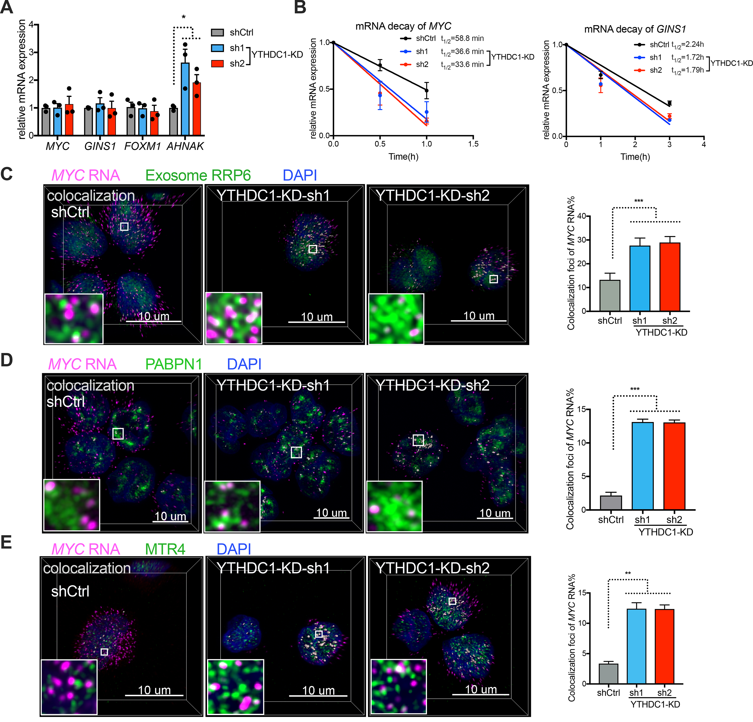
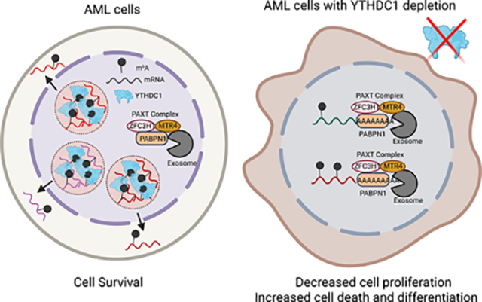
mRNA modifications: m6A in cancer
LLPS protects YTHDC1 pro-leukemic targets from the nuclear RNA degradation machinery.

Slide 41
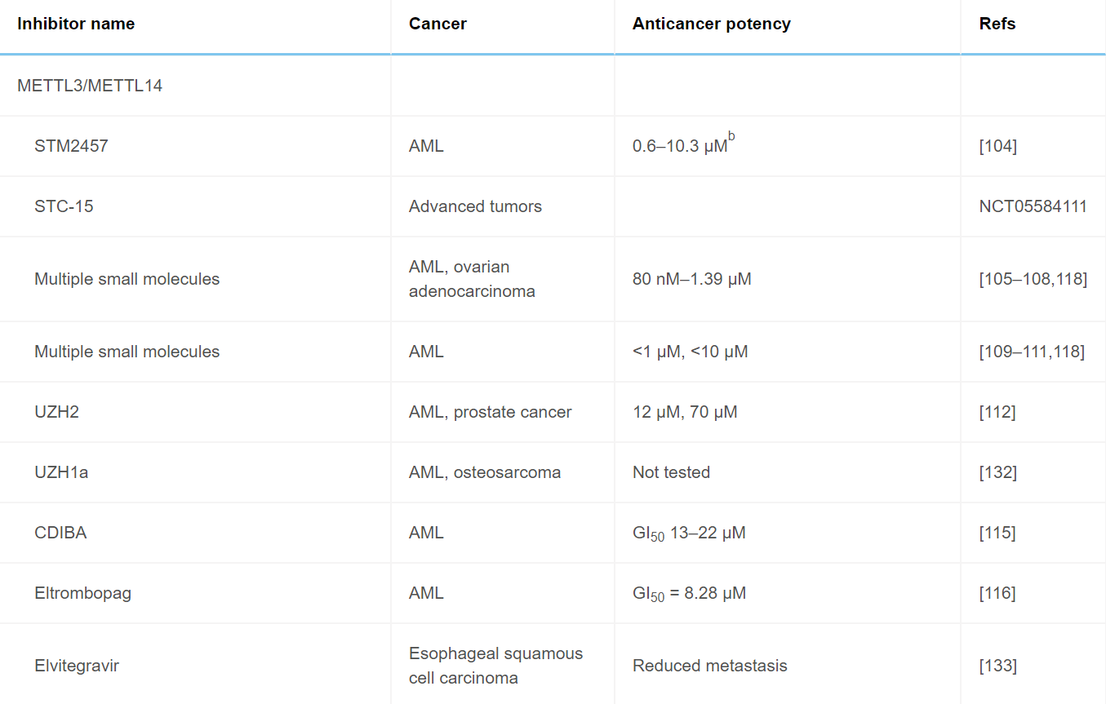
Targeting m6A in cancer

Slide 42

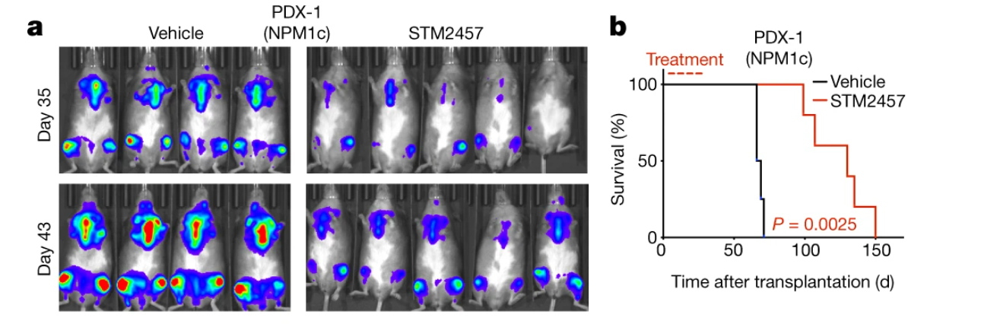
Targeting m6A in cancer

Slide 43
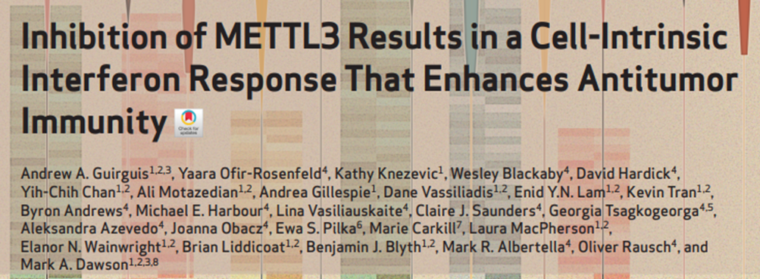
Targeting m6A in cancer

Slide 44

Targeting m6A in cancer

Slide 45

Targeting m6A in cancer

Slide 46


Targeting m6A in cancer
In vitro
METTL3 inhibitors increase sensitivity to immunotherapy in Melanoma cells
In vivo

Slide 47


Targeting m6A readers in cancer

Slide 48

Targeting m6A erasers in cancer

Slide 49


Targeting Ψ in cancer
PUS7 is upregulated in glioblastoma (GBM) and glioblastoma stem cells (GSS) compared to neuronal stem cells (NSC) and astrocites (AS)

Slide 50

Targeting Ψ in cancer
Downregulation of PUS7 affects glioblastoma PDX tumorigenesis in vivo

Slide 51

Targeting Ψ in cancer
Downregulation of PUS7 affects glioblastoma PDX tumorigenesis in vivo
A newly discovered PUS7 inhibitor affects glioblastoma PDX tumorigenesis in vivo

Slide 52


Targeting Ψ in cancer
tRNA-Arg-CCG-2-1 Ψ50 inhibitd TYK2 tumor suppressor translation and IFN response in Glioblastoma

Slide 53

Current epitranscriptomic therapeutic strategies in cancer

